Slide 1
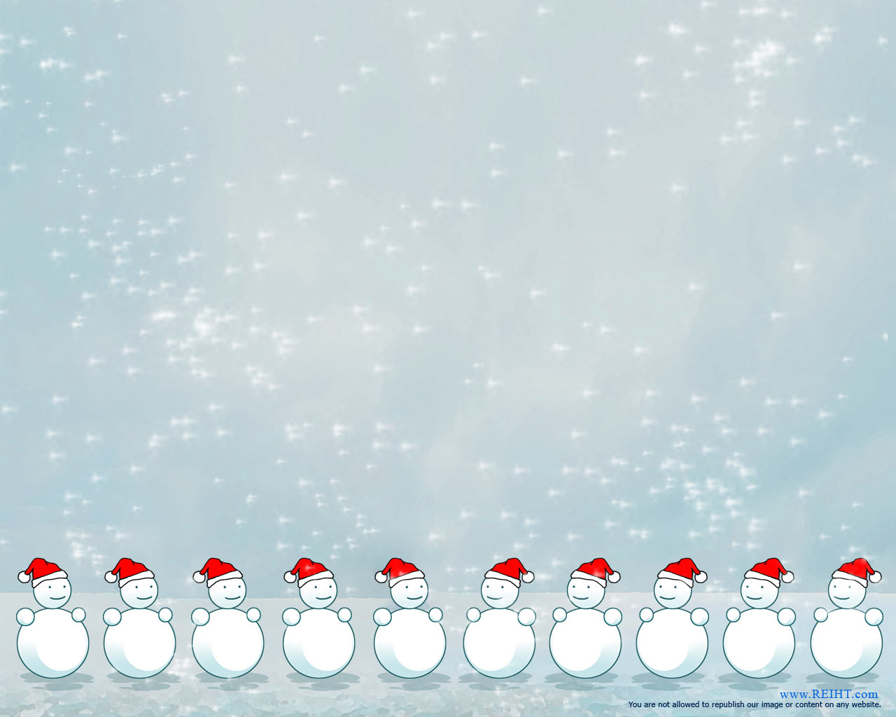
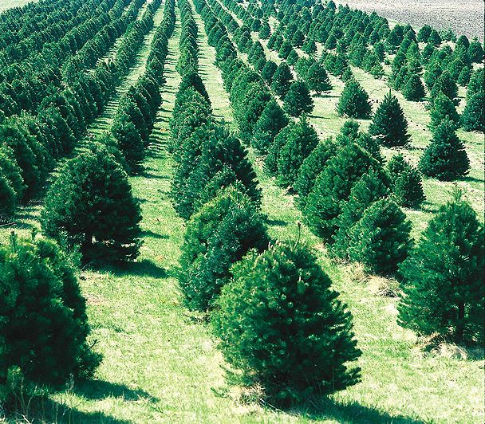
Merry MATHmas!
Ms. Pough runs a Christmas Tree Farm in the winter. She purchased 16 trees to plant. She needs help arranging the trees in equal rows and columns. What might her tree farm look like?

Slide 2
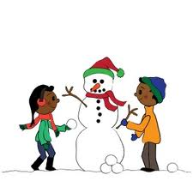
Merry MATHmas!
The snow has finally landed in Stockbridge, GA. The children are so excited to make snowmen. Each snowman must be made using three balls of snow. How many snowmen can you make if you rolled 15 balls of snow? Prove your thinking using pictures and words.

Slide 3
Merry MATHmas!
The stable door is closed and all you can see is legs under the door. If you see 20 legs, how many reindeer and elves could be in the stable?

Slide 4

Merry MATHmas!
Ms. Laverick decided to make gingerbread cookies for the 2nd grade teachers at SES. Each box has 3 cookies. If there are 6 teachers at SES, how many cookies did Ms. Laverick bake?
Prove your thinking with pictures and words.

Slide 5

Merry MATHmas!
Ms. Robinson loves to hang candy canes around the house. On the first day, she hung 2 candy canes. On the second day, she hung 4 candy canes. On the third day, she hung 8 candy canes. How many candy canes will she hang on the 5th day?
Do you notice a pattern? Explain it?

Slide 6
Merry MATHmas!
Ms. Wilder helps The elf on the left to make 3 toys a day. How many toys will they make in 4 days? Explain your thinking!

Slide 7
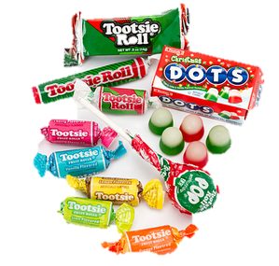
Merry MATHmas!
Ms. Smith has 4 bags of candy. Each bag has 6 pieces. How much candy does she have? What strategy can you use to prove your thinking?

Slide 8



Merry MATHmas!
Ms. Wall needs help decorating the bottom row of the tree. Draw a picture to help her make a plan. What do you notice? How many should be on the last row?
How many ornaments are there in all?

Slide 9

Merry MATHmas!
Ms. Bailey went shopping on Monday and bought 2 presents. On Tuesday she bought 2 presents and on Wednesday she bought 2 presents. If this pattern continued until Sunday, how many presents would Ms. Bailey have to wrap on Sunday night?

Slide 10

Merry MATHmas!
Mr. Johnson’s class built 17 snowmen during recess on Monday, 24 on Tuesday, and 10 on Wednesday. How many snowmen did the students make in all? How many would be left if 12 melted?

